Slide 1
Predicting Hospital Readmission Risk With Chronic Condition
Presented by: team id : TEAM(SC2)-09
team leader: subhasmita das, 23cse625
Team members : Wilson Sahani, 23ece059
pitta saiganesh, 23cse640
Gudla sindhuja, 23cse619

Slide 2
Why Readmission Risk Matters
1 in 5 chronic patients are readmitted within 30 days
Significant cost burden to healthcare systems
Preventable with early intervention
Notes:
Hospital readmissions are costly and often avoidable. Identifying at-risk patients enables early action.

Slide 3
Project Goal
Predict high-risk patient readmissions
Use hospital data and patient history
Enable preventive care before discharge

Slide 4
Dataset Description
Synthetic hospital records (~X patients)
Demographics: Age, Gender
Clinical data: Condition, Medication
Admin data: Hospital, Insurance
Target: Readmitted (Yes/No)

Slide 5
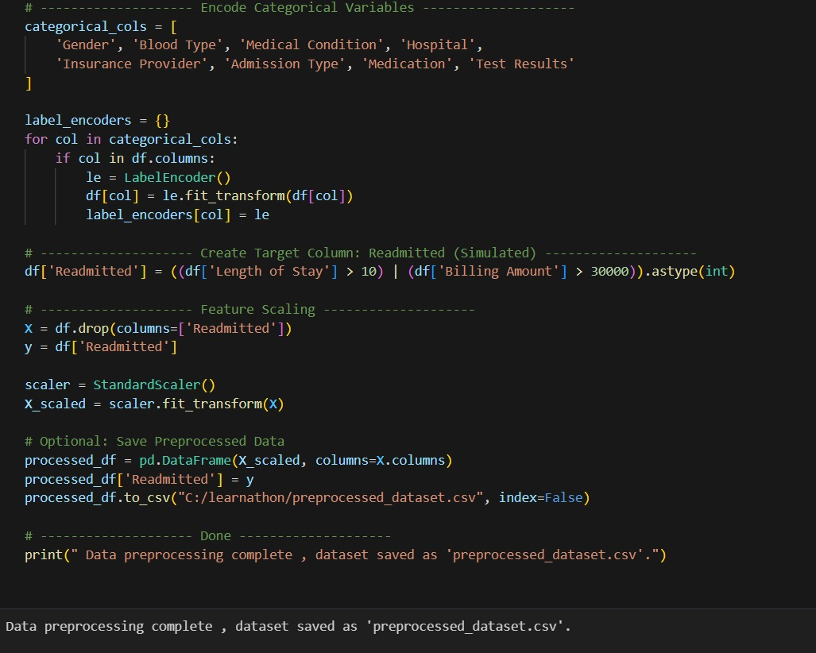
Data Preprocessing
Dropped irrelevant columns
Parsed date fields and calculated Length of Stay
Label encoded categorical variables
Scaled features using StandardScaler
Simulated readmission label

Slide 6
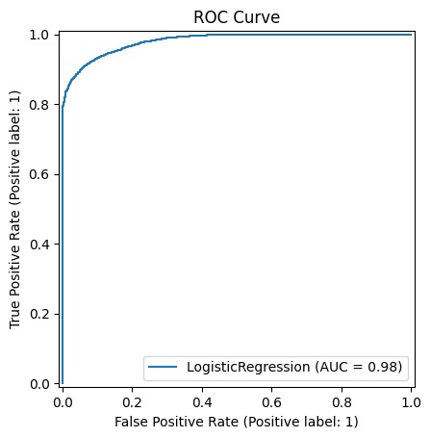
Logistic Regression Model
Binary classification for readmission
Interpretable and efficient
Train/Test Split: 80/20
Max iterations: 3000

Slide 7
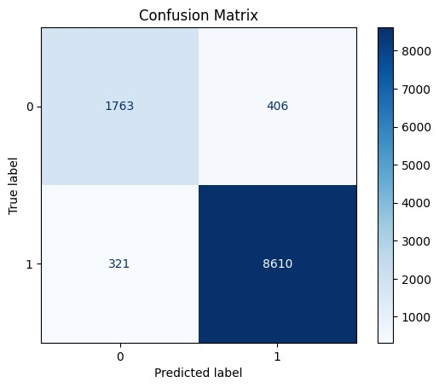
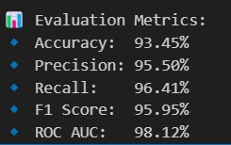
Evaluation Metrics
Accuracy: 93.45%
Precision: 95.50%
Recall: 96.41%
F1 Score: 95.95%
ROC AUC: 98.12%
Notes:
Model performance evaluated using multiple metrics and ROC/Confusion Matrix.

Slide 8
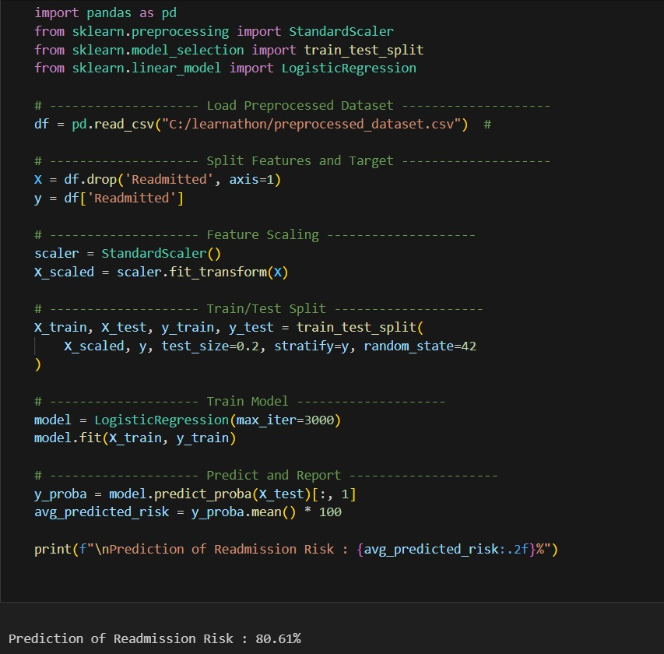
Key Features Driving Readmission
Length of Stay
Billing Amount
Medical Condition
Medication and Test Results

Slide 9
Deployment Ready
Model saved using joblib
Preprocessing pipeline preserved
Can be integrated with Flask UI
Scalable to real-time hospital data

Slide 10
Conclusion & Future Steps
ML helps flag high-risk patients
Supports clinical decision-making
Future: test on real EHRs, explore ensemble models

Slide 11
Questions & Discussion
Open for Q&A
Feedback Welcome

